Slide 1
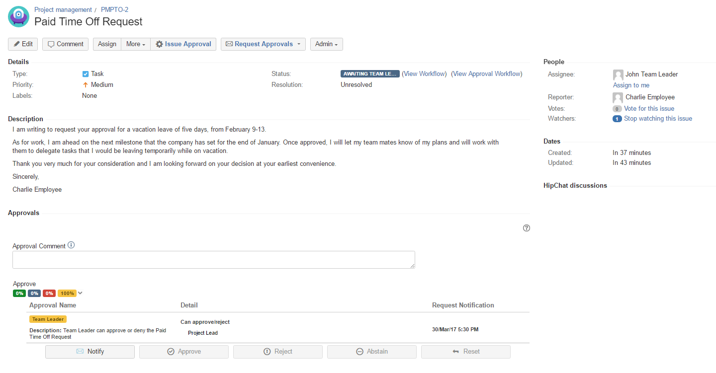

A Paid Time Off request created by Charlie Employee

Slide 2
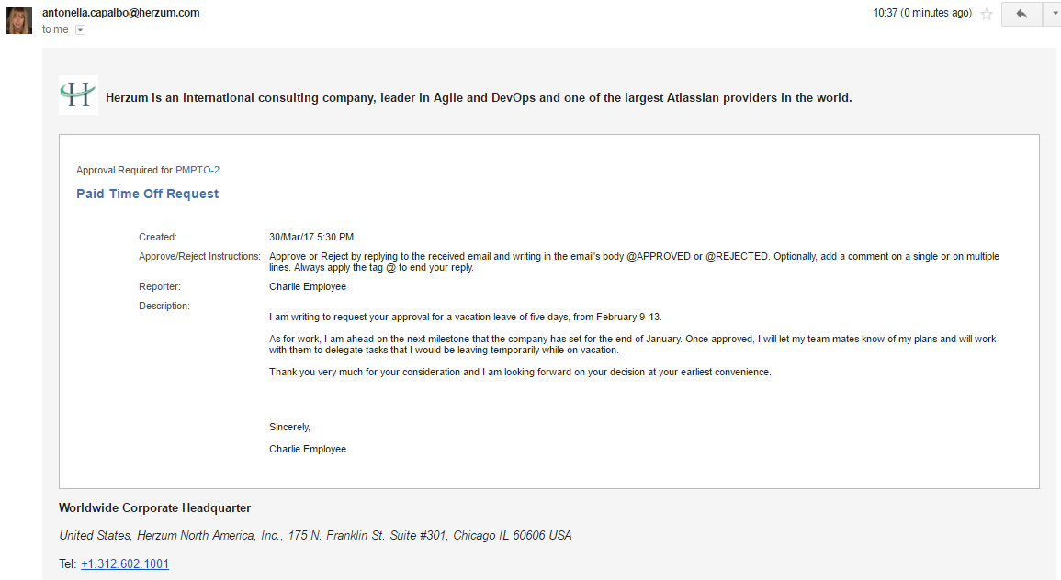

JohnTeamLeader@herzum.com
John Team Leader is automatically notified via email of any Paid Time Off Request submitted for approval

Slide 3
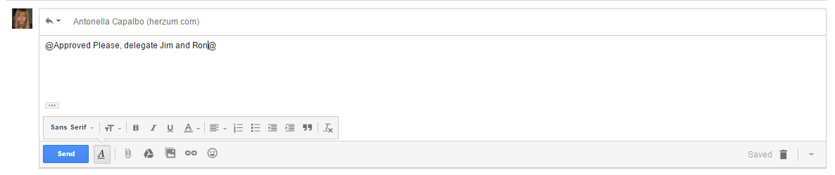
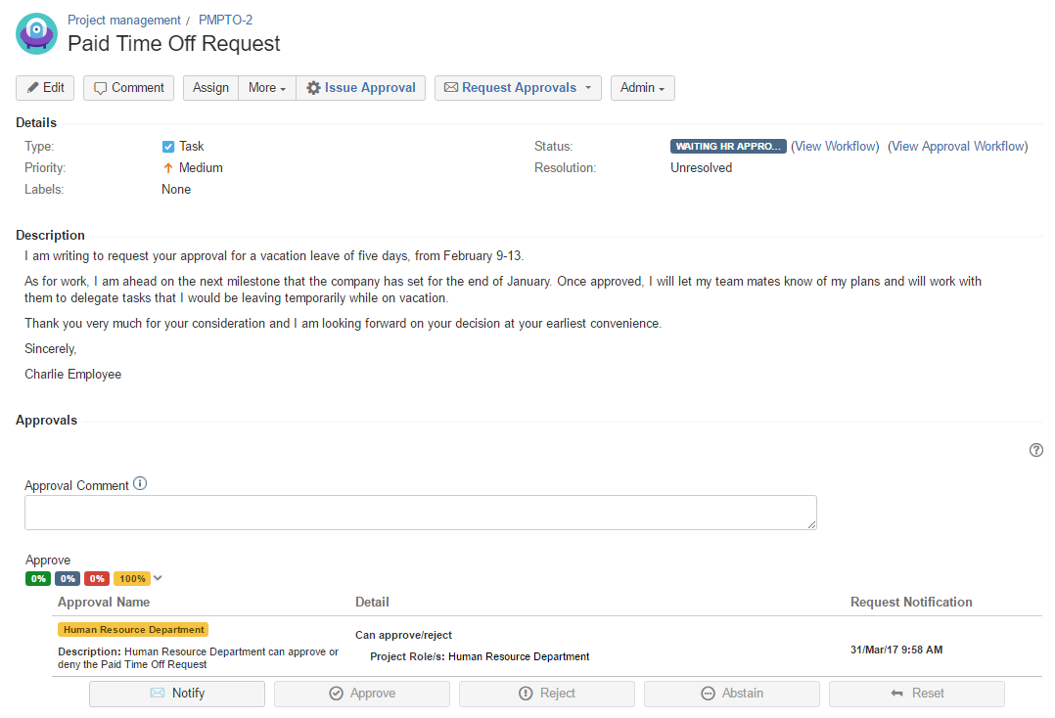
JohnTeamLeader@herzum.com
John Team approves via email
The issue automatically moves in the status Waiting Human Resource Department approval

Slide 4

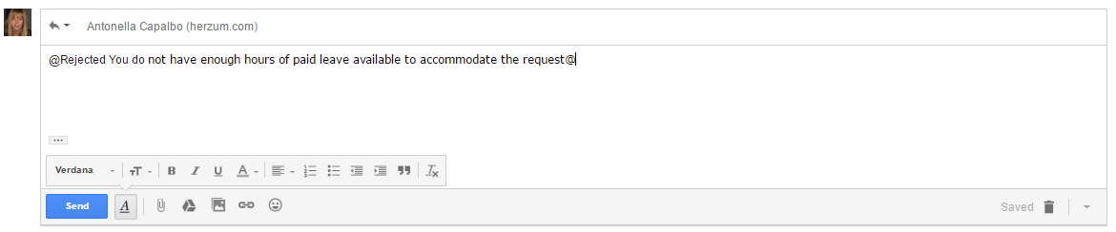
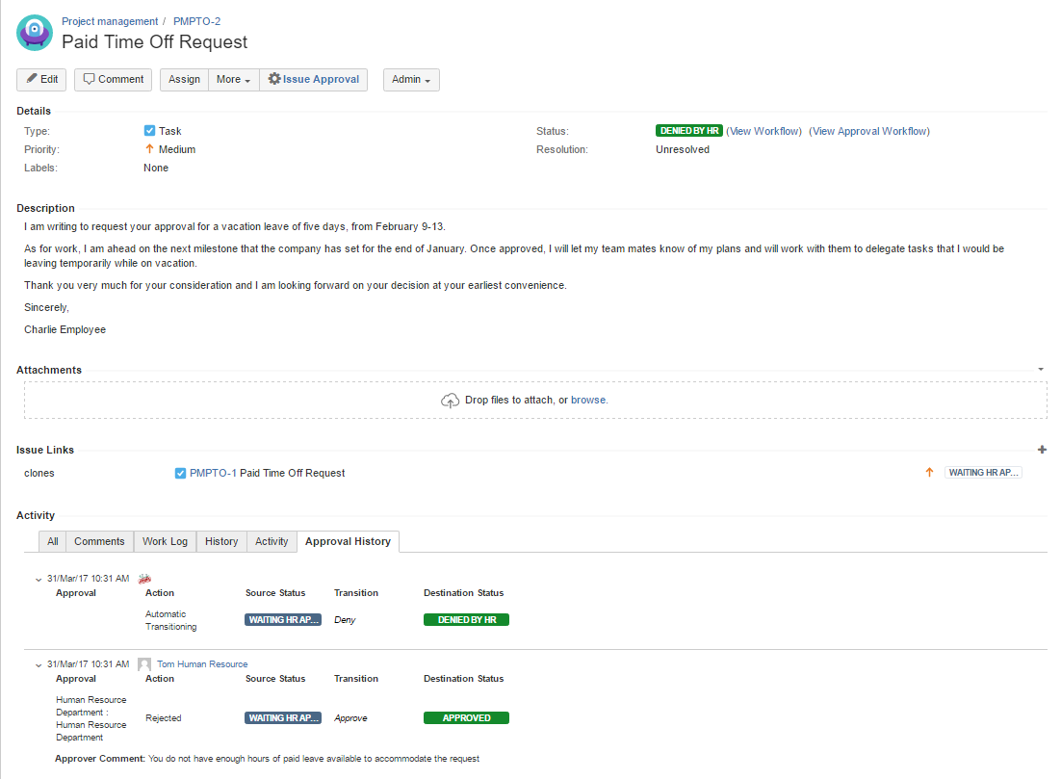
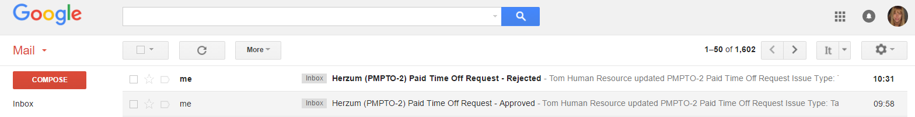

TomHumanResource@herzum.com
Tom Human Resource rejects via email
The issue automatically moves in the status Denied by Human Resource Department
Charlie Employee is notified via email that the approval request has been rejected

