Slide 1
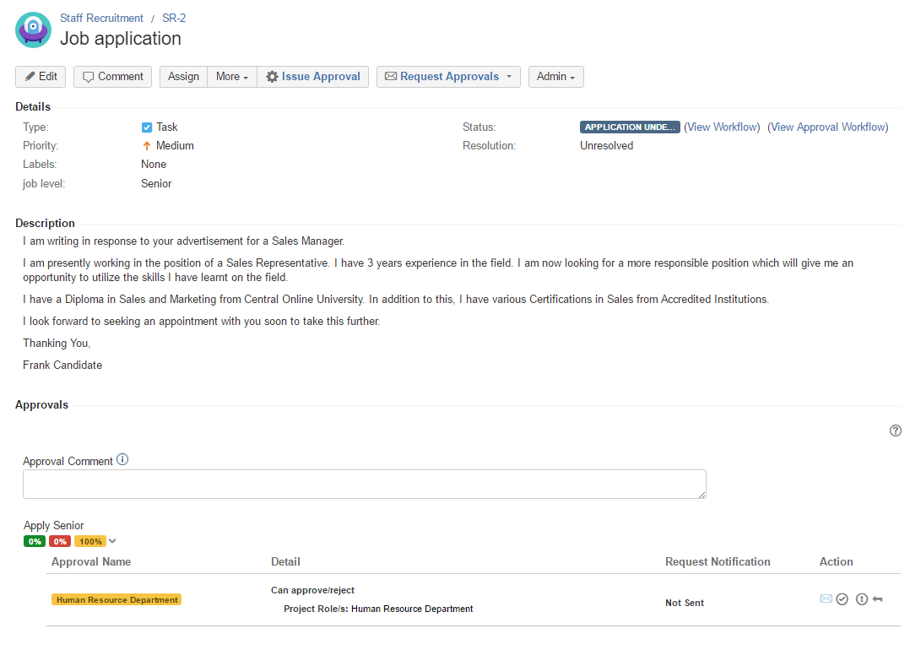
Frank Candidate applies his candidature for the job as Senior

Slide 2
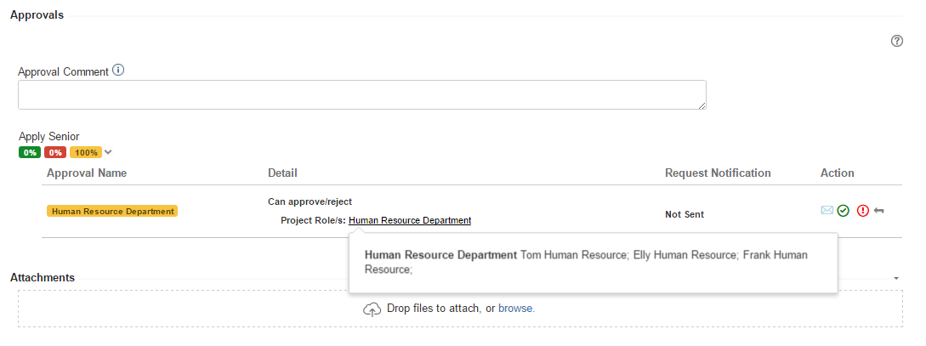
Any member of the Human Resource department can approve the candidature

Slide 3
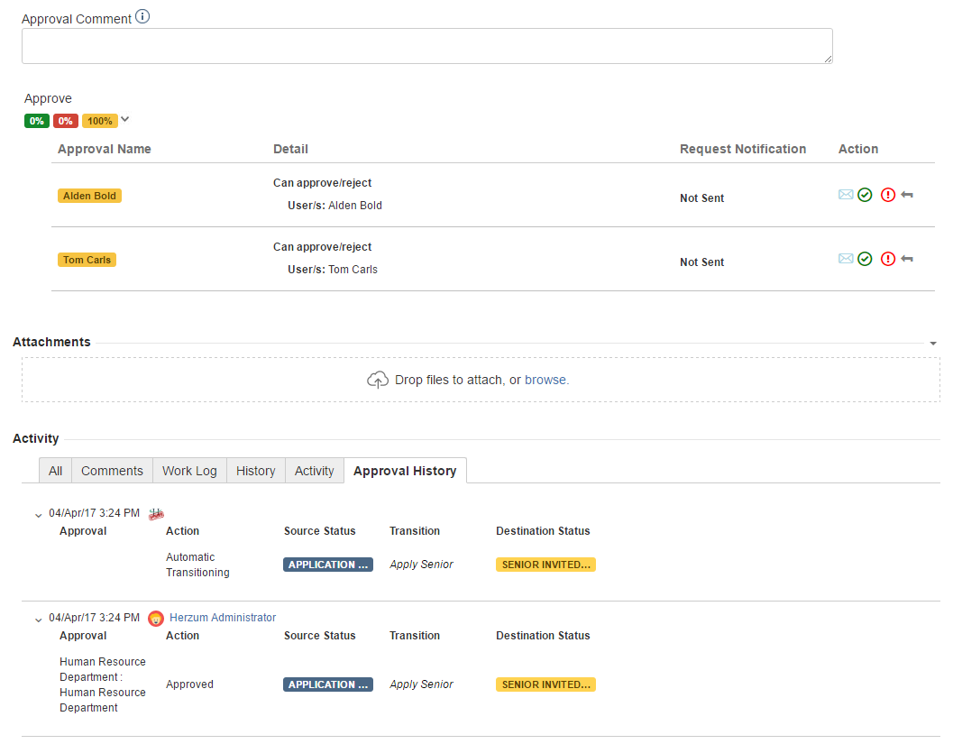
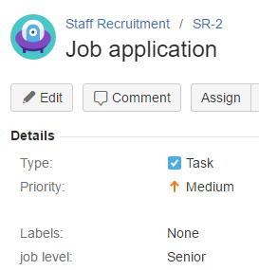
Elly Human Resource approved
Now the candidature requires Alden Bold and Tom Carls approbations cause of job level is Senior

Slide 4
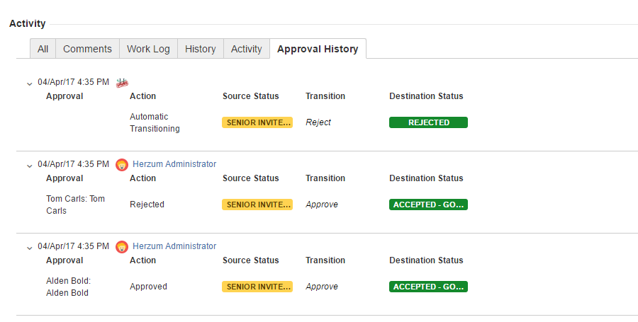
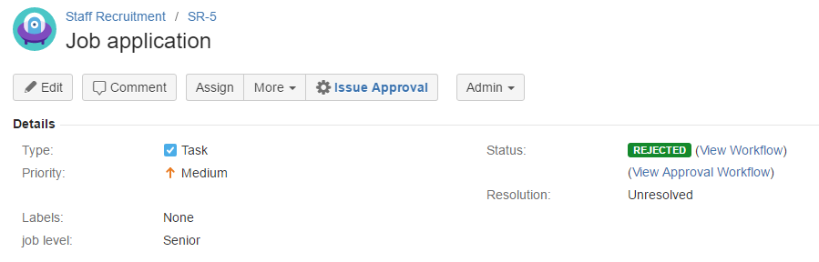

Alden Bold approves but Tom Carls Rejects
The issue automatically moves in the status Rejected

